Slide 1
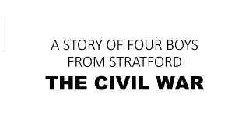
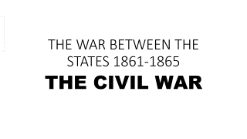
A STORY OF FOUR BOYS FROM STRATFORD
THE CIVIL WAR

Slide 2
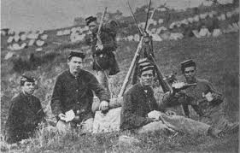
THIS IS THE STORY ABOUT FOUR FRIENDS FROM STRATFORD THAT WENT TO WAR

Slide 3
THE CIVIL WAR STARTED IN 1861
FOUR BOYS FROM THE SAME AREA OF STRATFORD DECIDE TO ENLIST IN THE 17TH DIVISION
HENRY AND SELAH BLAKEMAN (COUSINS)
SYLVESTER ROUNDS
STEPHEN CROFUT

Slide 4
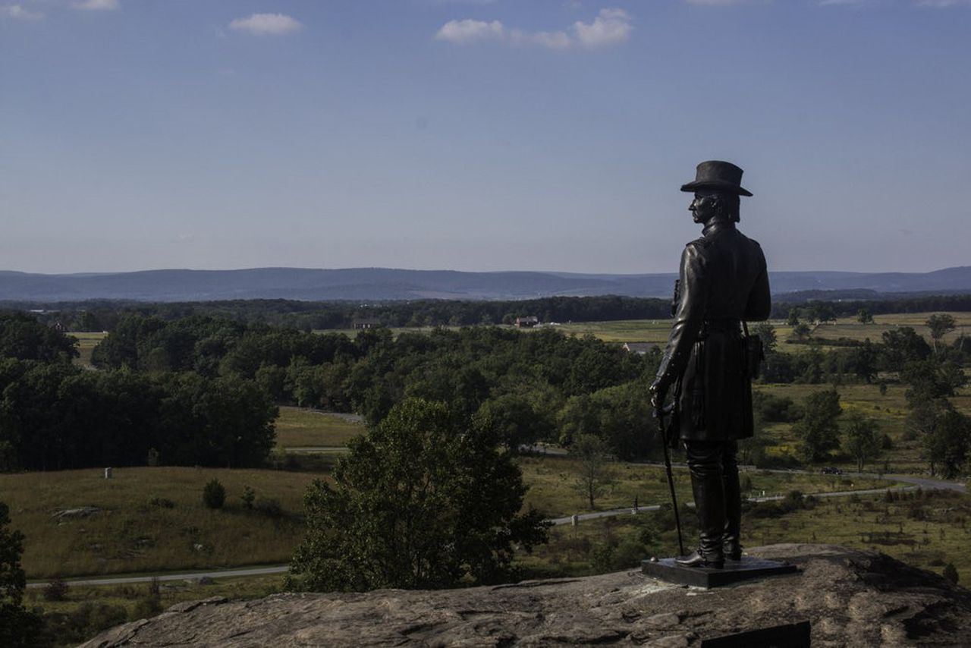
THIS IS THE STORY IS WHAT HAPPENED ON A JULY DAY IN 1863 IN A SMALL TOWN CALLED GETTYSBURG

Slide 5
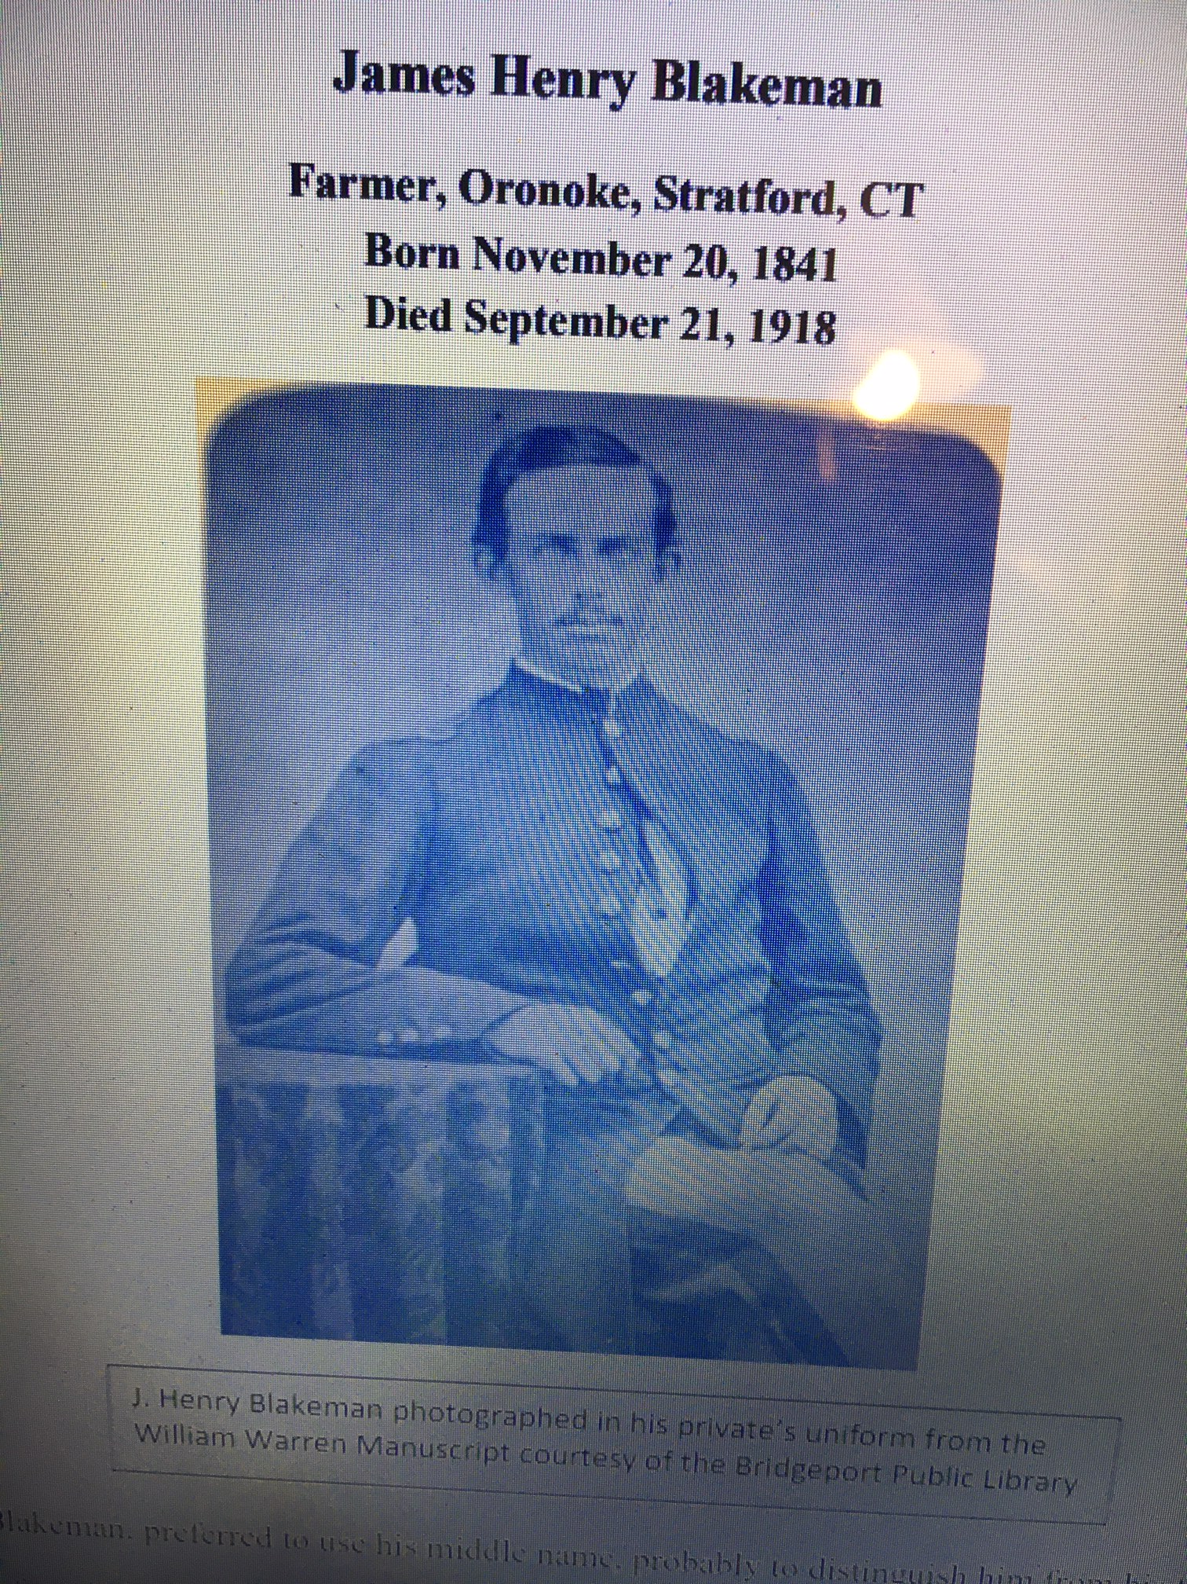
James Henry Blakeman
. The Blakeman family traced their roots to one of the original founders of Stratford, CT.
Henry Blakeman’s military roots went back to his grandfather, James Blakeman, who was a veteran of the Revolutionary War.

Slide 6
Sylvester Rounds (no picture)
Sylvester Rounds enlisted in the 17th Connecticut Regiment his home was listed as Huntington (Stratford)
He, Selah, Henry and Stephen would be together almost daily. They would see combat at Chancellorsville and narrowly escape capture.

Slide 7
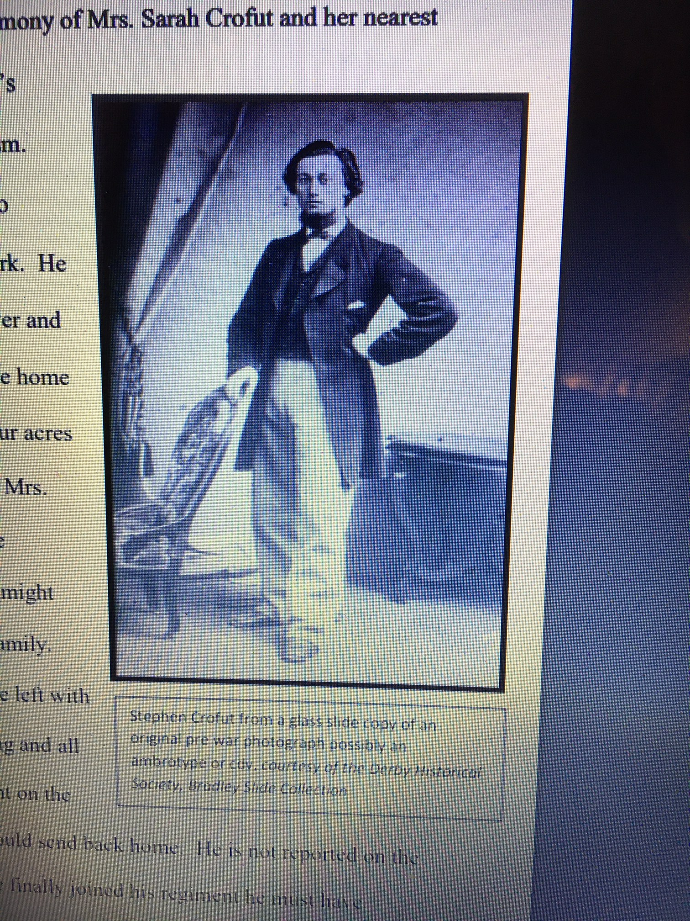
Stephen C. Crofut
Stephen Crofut would enlist along with his friends in July of 1862 for a term of three years or the duration of the war. He was 20 years old.
He, Henry, and Selah would be born within months of each other in 1841.

Slide 8
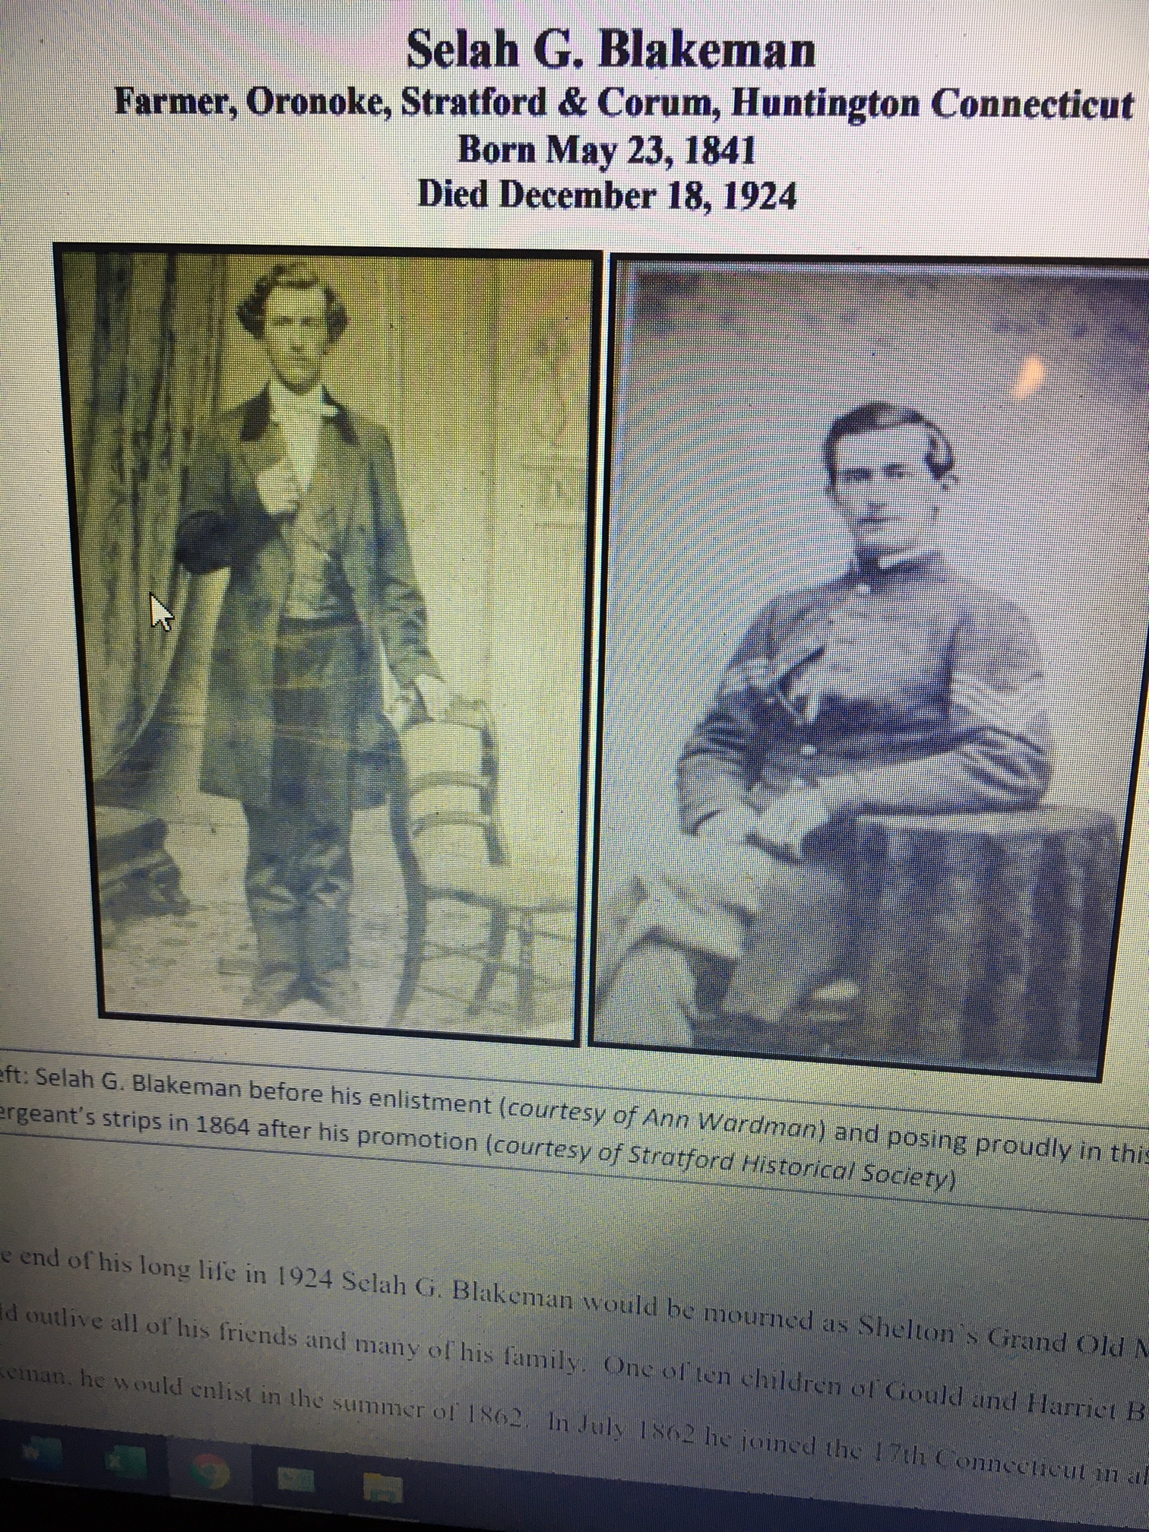
Selah Blakeman
He would be the only one of his friends left standing on July 1, 1863 on Barlow’s Knoll at Gettysburg

Slide 9
July 1, 1863 – First day of Battle of Gettysburg
Company D, 17th Connecticut Inf. Div.
There regiment supported Battery G, 4th U.S. Artillery, which had taken position on called Barlow Knoll.

Slide 10
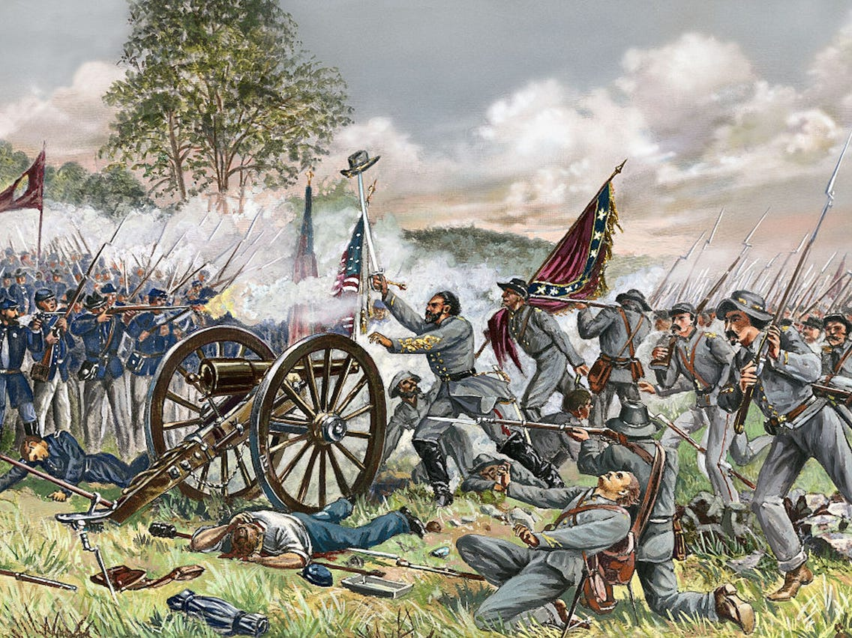
JULY 1ST GETTYSBURG
THE CONFEDERATES ARE ATTEMPTING TO GAIN THE KNOLL (HILL) ON THE UNION RIGHT
DEADLY ARTILLERY AND RIFLE
VOLLEYS WERE FLYING
EVERYWHERE

Slide 11
Henry Blakeman wrote a letter to Stephen’s mother, in it he said:
The battery was firing when Stephan said “those are ours, give it to them.” These were the last I heard him say as just then we moved towards the rebs and my attention was directed to them.
He must have been hit at the same moment that I was, for as soon as I got up I saw him lying near me and under his head a large puddle of blood.
I did not go to him for one look at his face satisfied me that he was dead and I could hardly move myself.

Slide 12
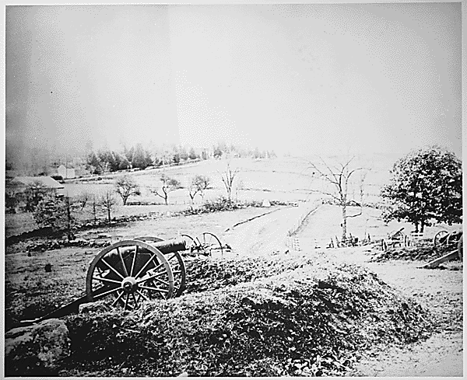
Barlow’s Knoll

Slide 13
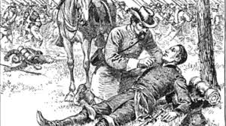
The 17th Connecticut Infantry at the Battle of Gettysburg
The regiment brought 386 men to Gettysburg, and lost 20 men killed, 81 wounded and 96 missing.
Stephen Crofut was dead
Henry Blakeman was wounded by a rifle ball in the left hip
Sylvester Rounds would be
wounded badly by a rifle ball to
the left shoulder and he would be
prisoner.
Selah Blakeman was the only
man left standing

Slide 14
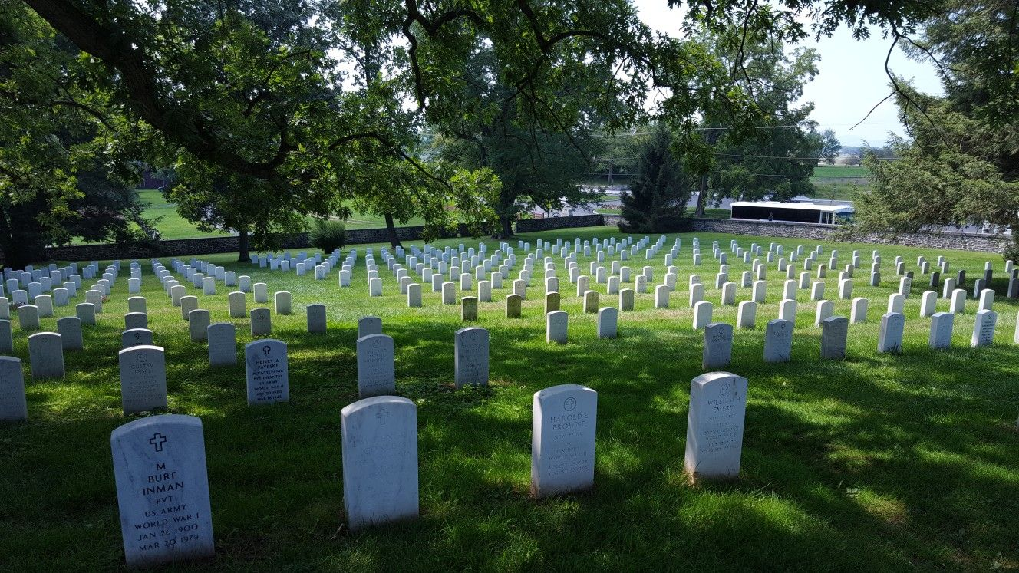
STEPHEN CROFUT
His body was never recovered and he is most probably one of the unknown Connecticut dead interred in the National Cemetery at Gettysburg

Slide 15
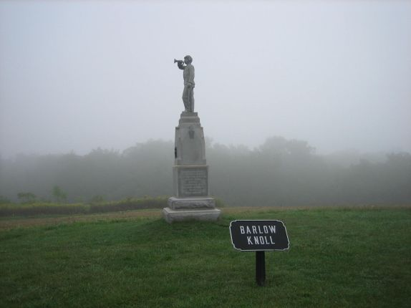
Here is Barlow Knoll today

Slide 16
HENRY- CAME BACK TO STRATFORD
After the war Henry was active in civic and veteran affairs.
He was a prominent citizen in Stratford and the State until his death in 1917.
In his obituary he would be described as the “dean of public men in Fairfield County.”

Slide 17
SELAH- CAME BACK TO STRATFORD
Selah returned from the war and married his sweetheart Codealia
Selah was civic minded and involved in community and veteran’s affairs his whole life long.

Slide 18
SYLVESTER- CAME BACK TO STRATFORD
Sylvester returned home from the war. He married Elizabeth Drew in 1866.
He became Vice President of the Ansonia Grain Company.
Sylvester Rounds would pass away February 18, 1899 at age 56 two weeks after being thrown from a sleigh

Slide 19
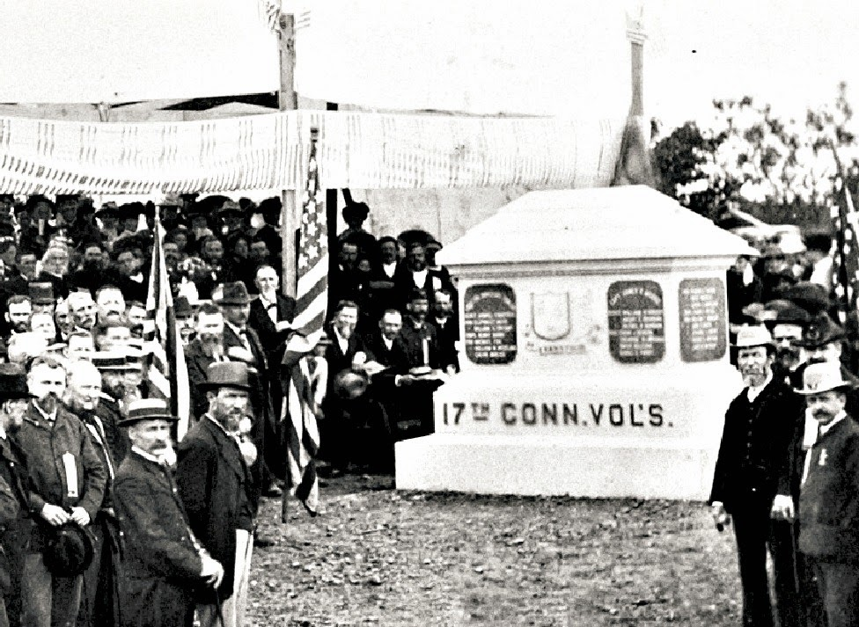
JULY 2, 1882
CEREMONY RECOGNIZING THE CONTRIBUTION OF THE 17TH DIV.
PRESENT ON THAT DAY WAS SELAH BLAKEMAN

Slide 20
SELAH
He would outlive all of the others.
He would have many accomplishments of which to be proud, but his proudest moments were a few minutes on a hill where he stood with his friends on a hot day in July 1863 at a place called Gettysburg

Slide 21
